Slide 1
Remind 101
A way to remind you of important assignments and events anonymously

Slide 2
Take out your cell phone!

Slide 3
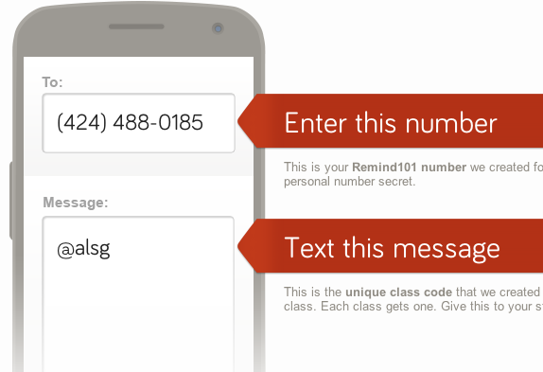
A Block Learning Seminar (GRIMES)

Slide 4
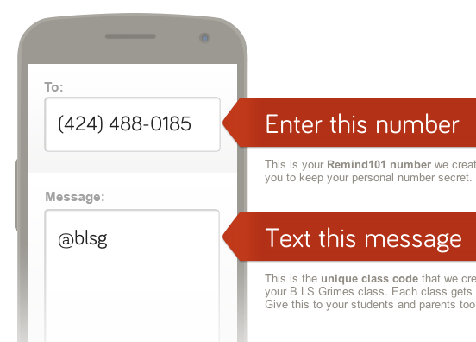
B Block Learning Seminar (GRIMES)

Slide 5
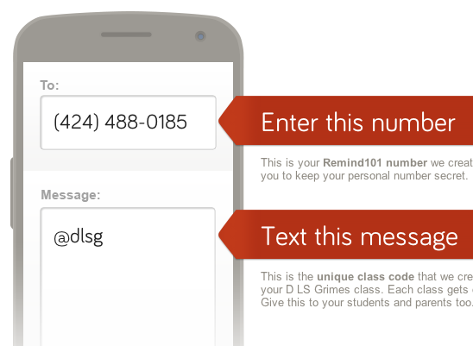
D Block Learning Seminar (GRIMES)

Slide 6
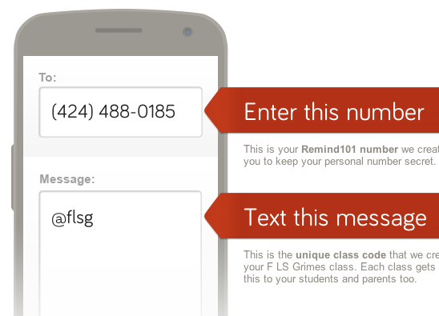
F Block Learning Seminar (GRIMES)

Slide 7
B Block Heritage 1 (ROSA)

Slide 8
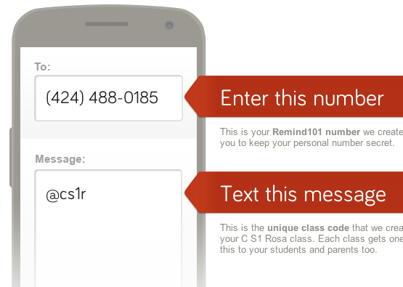
C Block Spanish 1 (ROSA)

Slide 9
D Block Heritage 1 (ROSA)

Slide 10
E Block Learning Seminar (ROSA)

Slide 11
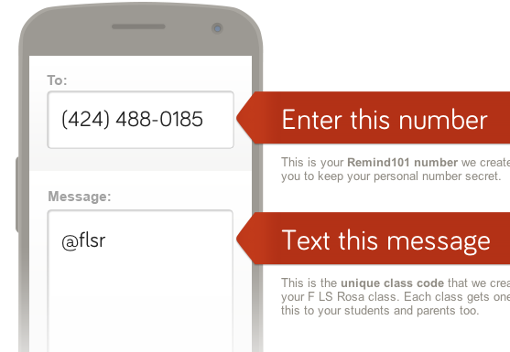
F Block Learning Seminar (ROSA)

Slide 12
Now, encourage your parents to sign up for text reminders using the SAME code that you used!

